Slide 1
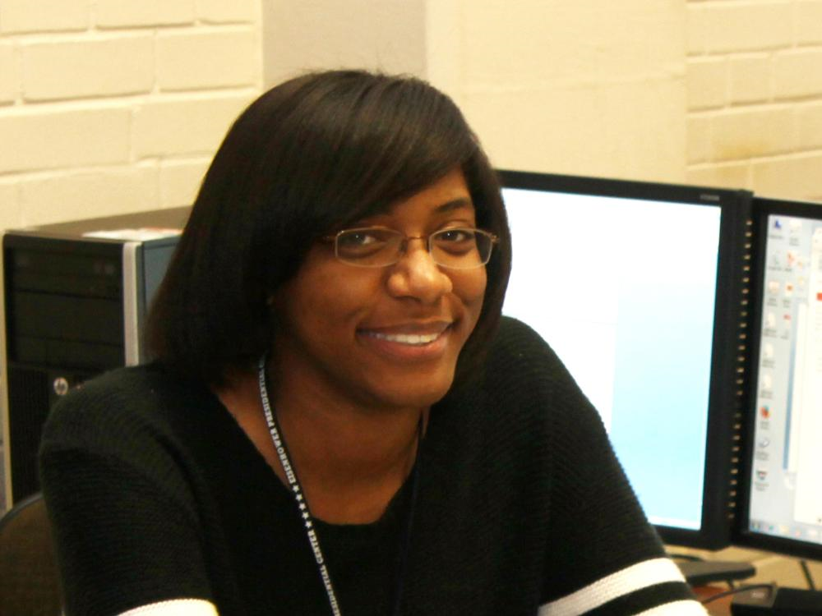
Hi! My name is Ashney Randle

Slide 2
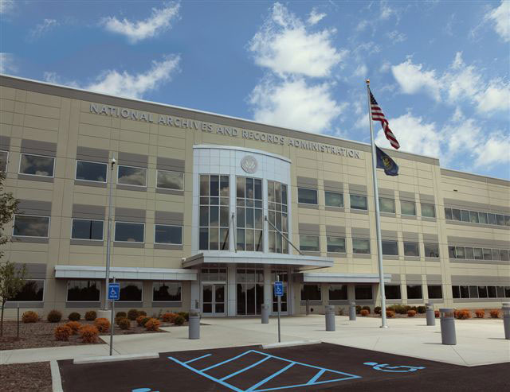
About Me
I am an LIS professional with 5 years experience working with the National Archives at St. Louis and the National Personnel Records Center
Graduating with a Masters in Library & Information Science in May 2021

Slide 3
Why LIS?
At first, I joined out of an interest in history and helping people find information.
Now?
My passion is to help improve library and archives operations run smoothly so that the public get’s quality customer service, and the talented staff who run the facilities can continue to do their best everyday.

Slide 4
Accomplishments
Created and maintained Standard Operating Procedures for 2 departments at the National Personnel Records Center
Certified in Federal Records Management in 2020
Currently serves as a member of the Archivists’ Task Force on Racism with a focus on producing recommendations for improving employee experience at the National Archives

Slide 5
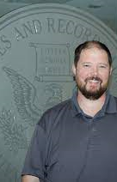
Kudos
“Ashney continues to impress with her dependability and thoroughness. She has become a “go-to” person when high priority tasks arise and always ensures the job is done right the first time. Her work ethic is sound, sets the bar high, and is a great example for others to follow. Her can-do attitude inspires those around her and contributes directly to the success of our operation. She takes every step necessary to ensure the success of the research room and her colleagues. ”
-Eric Kilgore, former Supervisor

Slide 6
Thank You!
I hope to hear from you soon!

